Slide 1
Exercise 5A – Wages and Salary

Slide 2
Daily Review
Bob works in a shop. He works 20 hours during the week and sometimes works an extra 8 hours on Saturdays.
Wages: Hourly rate of pay. Extra work may be paid as overtime at penalty rates (time-and-a-half, double time).
Ava is a teacher. She gets paid the same amount each fortnight. She works at home a couple of evenings a week and on Saturday mornings, but doesn’t get paid extra.
Salary: Weekly, monthly or annual rate of pay. Overtime not usually paid; time off may be given instead.
Commission: Retainer or flat fee plus percentage of the value of sales made, or a certain amount of every sale.
Danielle works in real estate. She gets paid $500 a week, plus $1200 for every house she sells.
Piece work: Payment per item produced.
Cameron shears sheep. He gets paid $30 for every sheep he shears.

Slide 3
Daily Review
VOCABULARY
Wage – hourly rate of pay
Sim is employed as an intern at a photographic studio.
Sim’s job is covered by an agreement that says he must be paid a standard hourly rate
of $15.80 for a standard 38 hour Monday to Friday week.
On Saturday he is paid time-and-a-half (1.5 x $15.80) for the first 3 hours and
double time (2 x $15.80) for any additional hours after that.
One week, Sim worked his normal week, plus 4.5 hours on Saturday.
How much money did he earn that week?
Standard hours: 38
Time-and-a-half hours: 3
Double time hours: 1.5
38 x 15.8 = 600.40
3 x (1.5 x 15.8) = 71.10
1.5 x (2 x 15.8) = 47.40
Sim earnt $718.90 that week.

Slide 4
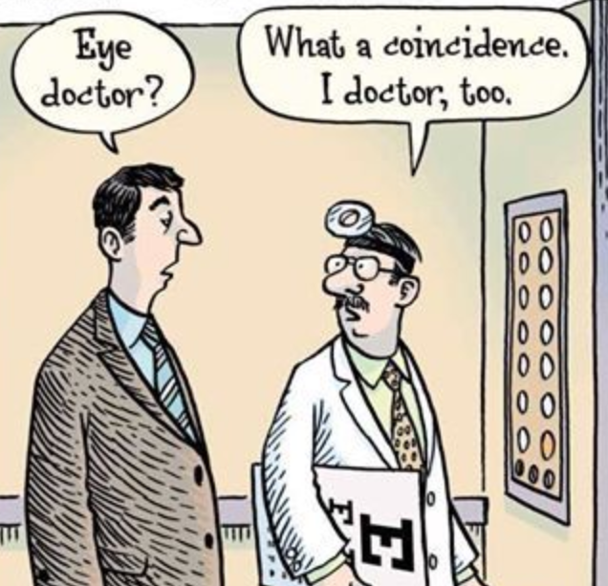
Daily Review
VOCABULARY
Salary – weekly, monthly or annual rate of pay
A doctor earns a salary of $120 000 per annum (yearly).
They get paid fortnightly.
Assuming there are exactly 26 fortnights in a year, how much do they earn each pay?
CFU 1
How many payments a year would you receive if you were paid weekly? If you were paid weekly, you would receive ……….
If there are 26 fortnights in a year, and the doctor gets paid every fortnight, this means their salary is paid to them in 26 equal instalments.
$$120 000÷26=\$4615.38$$
The doctor earns $4615.38 per pay.

Slide 5
Daily Review
VOCABULARY
Salary – weekly, monthly or annual rate of pay
A doctor earns a salary of $120 000 per annum (yearly).
They get paid monthly.
How much do they earn each pay?
CFU 1
How many payments a year would you receive if you were paid weekly? If you were paid weekly, you would receive ……….
If there are 12 months in a year, and the doctor gets paid every month, this means their salary is paid to them in 12 equal instalments.
$$120 000÷12=\$10 000$$
The doctor earns $10 000 per pay.

Slide 6
Daily Review
VOCABULARY
Salary – weekly, monthly or annual rate of pay
A doctor earns a salary of $120 000 per annum (yearly).
They get paid weekly.
Assuming there are exactly 52 weeks in a year, how much do they earn each pay?
CFU 1
How many payments a year would you receive if you were paid weekly? If you were paid weekly, you would receive ……….
If there are 52 weeks in a year, and the doctor gets paid every week, this means their salary is paid to them in 52 equal instalments.
$$120 000÷52=\$2307.69$$
The doctor earns $2307.69 per pay.

Slide 7
Daily Review
Calculating salary:
Work out how many pays there will be in one year. Multiply the pay by this amount.
Find the annual salary of a nurse whose weekly pay is $1589. Assume there are exactly 52 weeks in a year.
There will be 52 pays a year.
$$1589×52=\$82 628$$
The nurse earns $82 628 per annum.

Slide 8
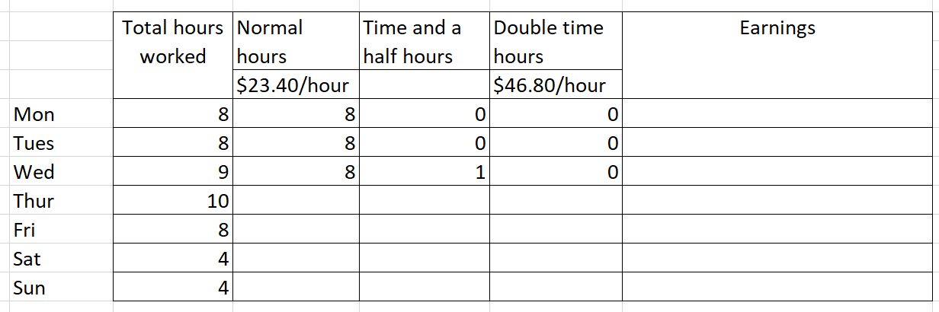
Y11 Apps Chapter 5 Situation 1
Jemima works for a company and her normal rate of pay is $23.40 per hour. However:
If she works more than 8 hours on a weekday, further hours are paid at ‘time and a half’.
Any Saturday hours are paid at ‘time and a half’.
Any Sunday hours are paid at ‘double time’.
Complete the wage slip for Jemima.
x1.5
x2
$35.10/hour
8 x 23.4 = $187.20
8 x 23.4 = $187.20
8 x 23.4 + 1 x 35.1 = $222.30
8 2 0 8 x 23.4 + 2 x 35.1 = $257.40
8 0 0 8 x 23.4 = $187.20
0 4 0 4 x 35.1 = $140.40
0 0 4 4 x 46.8 = $187.20
Total earnings for week: $1368.90

Slide 9
Y11 Apps Chapter 5 Situation 2
Now do Exercise 5A
Tom is looking in the newspaper for clerical jobs and sees the advertisement partially shown on the right.
Tom is 22 years old and wants to know:
How much this job would pay per week.
How much this job would pay per fortnight.
How much this job would pay per month.
How much weekly income would increase once he is 25.
WANTED
ACCOUNTS CLERK
Annual salary:
Aged 20-24 $58 000
Aged 25+ $65 000
Pay per week: 58 000 / 52 = $1115.38
Pay per fortnight: 58 000 / 26 = $2230.77
Pay per month: 58 000 / 12 = $4833.33
Pay per week once 25: 65 000 / 52 = $1250
1250 – 1115.38 = $134.62 more a week
(We have assumed there are exactly 52 weeks and 26 fortnights in a year.)

Slide 10
Exercise 5B – Comparing Prices

Slide 11
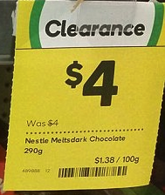
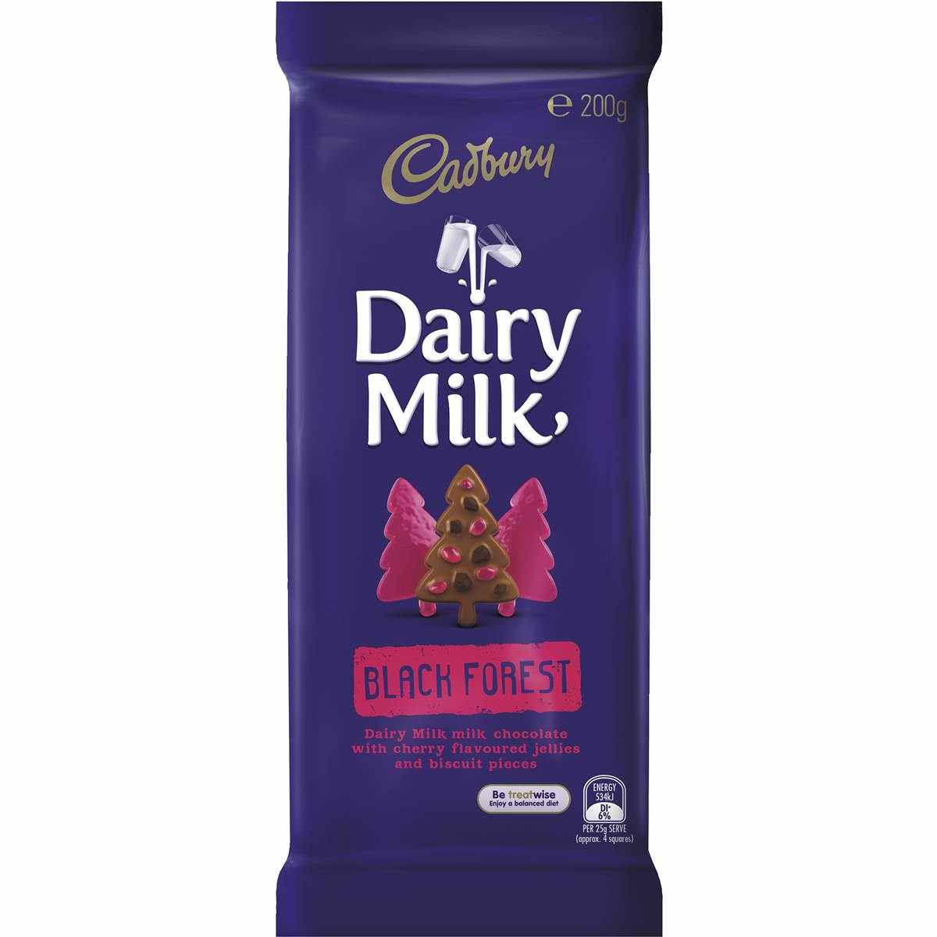
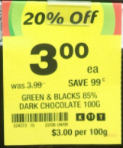

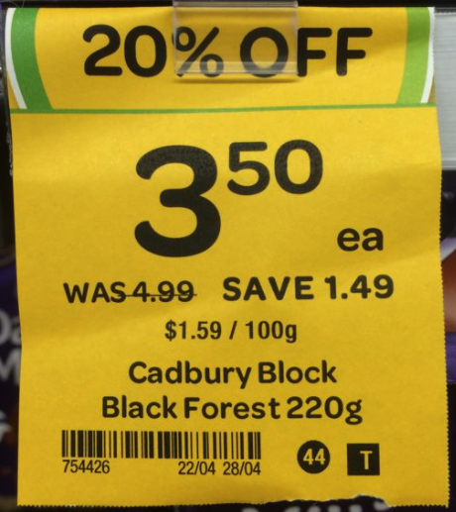
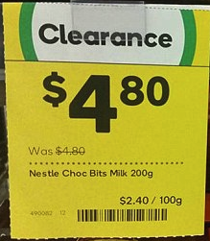
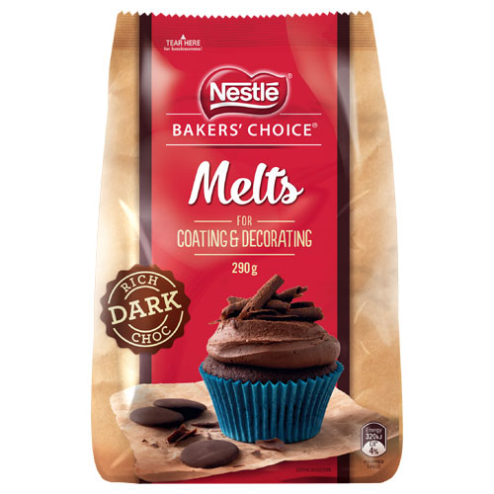
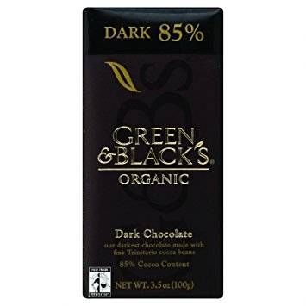
Daily Review
$4.00
for a 290 g bag
$3.00
for a 100 g block
In 2009, the Australian Federal Government made it compulsory for all large supermarkets to display Unit Price information with particular grocery items. Look for these the next time you are in a large supermarket!
$3.50
for a 220 g block
$4.80
for a 200 g bag

Slide 12
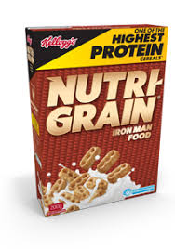


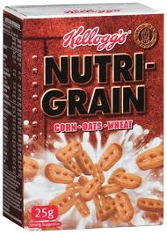
Daily Review
Which is better value for money?
Find the
Unit Price per 1g
500 g box
for $5.99
820 g box
for $7.21
60 g bag
for $3.14
140 g bag
for $7.52
5.99 / 500
= 0.01198
7.21 / 820
= 0.00879
3.14 / 60
= 0.052
7.52 / 140
= 0.054
$0.012 per 1g
$0.009 per 1g
$0.052 per 1g
$0.054 per 1g

Slide 13


Daily Review
Which is better value for money?
Find the
Unit Price per 100g
500 g box
for $5.99
820 g box
for $7.21
500 g jar
for $3.30
85 g packet
for $0.60
5.99 / 5
= 1.198
7.21 / 8.2
= 0.879
3.30 / 5
= 0.66
0.60 / 0.85
= 0.706
$1.20 per 100g
$0.88 per 100g
$0.66 per 100g
$0.71 per 100g

Slide 14

Y11 Apps Chapter 5 Situation 3
Consider the three different sizes of coffee jars you can buy in the local supermarket.
Which of these three gives the best value for money?
Per 100g - $8.90
Per 100g - $9.00
Per 100g - $9.20
200g - $17.80
100g - $9.00
50g - $4.60
This example is quite easy because the little jar is half the size of the middle jar and the big jar is twice as big as the middle jar. We can easily compare them.

Slide 15
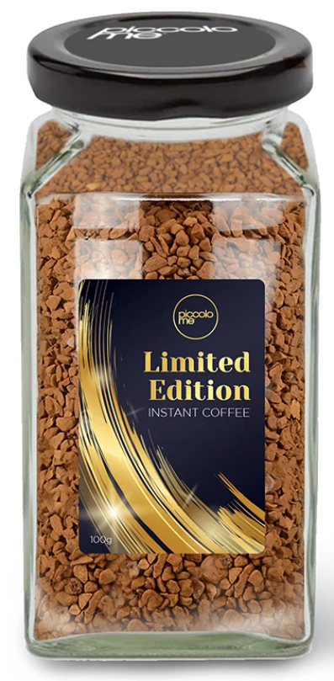
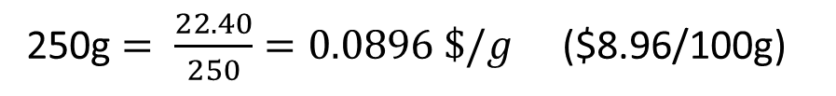
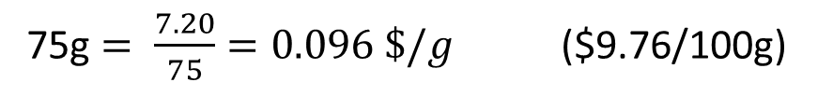
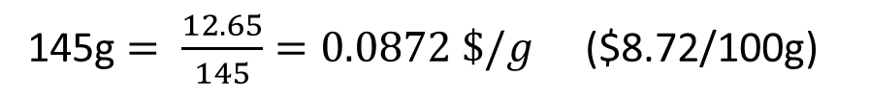
Y11 Apps Chapter 5 Situation 4
Now do Exercise 5B
Consider the three different sizes of coffee jars you can buy in the local supermarket.
Which of these three gives the best value for money?
250g $= \frac{22.40}{250}=0.0896 \$/g$ ($8.96/100g)
145g $= \frac{12.65}{145}=0.0872 \$/g$ ($8.72/100g)
75g $= \frac{7.20}{75}=0.096 \$/g$ ($9.76/100g)
250g - $22.40
145g - $12.65
75g - $7.20
This example is trickier as the jars aren’t doubles of each other.
We can compare the price per gram, or the price per 100g to see which one gives the best value.

Slide 16
Exercise 5C – Foreign Exchange

Slide 17
There are lots of different currencies around the world.
Daily Review
Australia (dollars): AUD, A$, $A
New Zealand (dollars): NZD, NZ$, $NZ
United Kingdom (pound sterling): £ , GBP
Japan (yen): ¥
United States of America (dollars): USD, US$

Slide 18
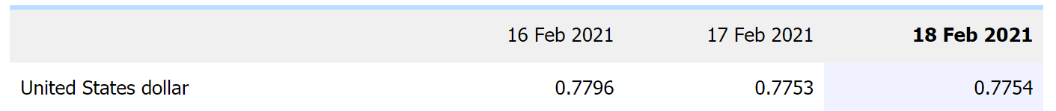
Y11 Apps Chapter 5 Situation 5
If you travel overseas you will need to exchange Australian currency for the currency used in the country you are visiting.
You might choose to use Australian money to buy bank notes (cash) in the foreign currency, or you might purchase traveller’s cheques that can be exchanged for currency in the other country (more common in the past) or load up a prepaid travel card with foreign currency (more common now).
To determine how much foreign currency we can get for our Australian dollars, we need to know the exchange rate for the two currencies. These rates can vary day to day.
To convert Australian Dollar into another currency MULTIPLY by the rate.
To convert another currency into Australian Dollar DIVIDE by the rate.

Slide 19
Y11 Apps Chapter 5 Example 1
Now do Exercise 5C
To convert Australian Dollar into another currency MULTIPLY by the rate.
To convert another currency into Australian Dollar DIVIDE by the rate.
With one Australian dollar being equal to 54.9071 Indian Rupees:
How many Rupees could be bought for A$250?
How many A$ could be bought for 2500 Rupees?
a) 250 x 54.9071 = 13 726.78 Rupees ( 13 726 rounded down as you cannot purchase 13 727 )
b) 2500 ÷ 54.9071 = 45.53 ( A$45.53 to the nearest cent)

Slide 20
Exercise 5D – Shares

Slide 21
Y11 Apps Chapter 5 Situation 6
Some people choose to invest money by buying shares.
A share is a unit of ownership in a company. If you buy shares in a company, you own part or a ‘share’ of that company.
How to make money from shares:
Buy the share at a low price and sell it at a high price (generally short term)
Dividends paid out by the company
Buy the share, keep it for a long time and wait for the value of the share to increase
If the company is doing well, the value of their shares may increase.
If the company is making a profit, they may pay out some of this profit to any shareholders.
The investor may see the value of their investment rise, as the share price increases.
The investor may also receive an annual payment, called a dividend, which is a share of the company’s profits.

Slide 22
Y11 Apps Chapter 5 Example 2
An investor owns shares in four companies as shown the by portfolio details below, which also shows the dividend per share for each company. Calculate the total value of the portfolio and the total dividend the investor will receive.
Company | Number of shares | Value per share ($) | Dividend per share ($)
ABC Limited | 4000 | 0.86 | 0.05
DEF Group | 550 | 23.50 | 1.45
GH Resources | 2500 | 3.40 | 0.28
IJ Technology | 8000 | 0.54 | No dividend
Total value of portfolio:
ABC: 4000 x 0.86 = 3440
DEF: 550 x 23.50 = 12925
GH: 2500 x 3.40 = 1350
IJ: 8000 x 0.54 = 4320
Total: = $22 035
Total dividend:
ABC: 4000 x 0.05 = 200
DEF: 550 x 1.45 = 797.50
GH: 2500 x 0.28 = 700
IJ: 8000 x 0 = 0
Total: = $1697.50

Slide 23
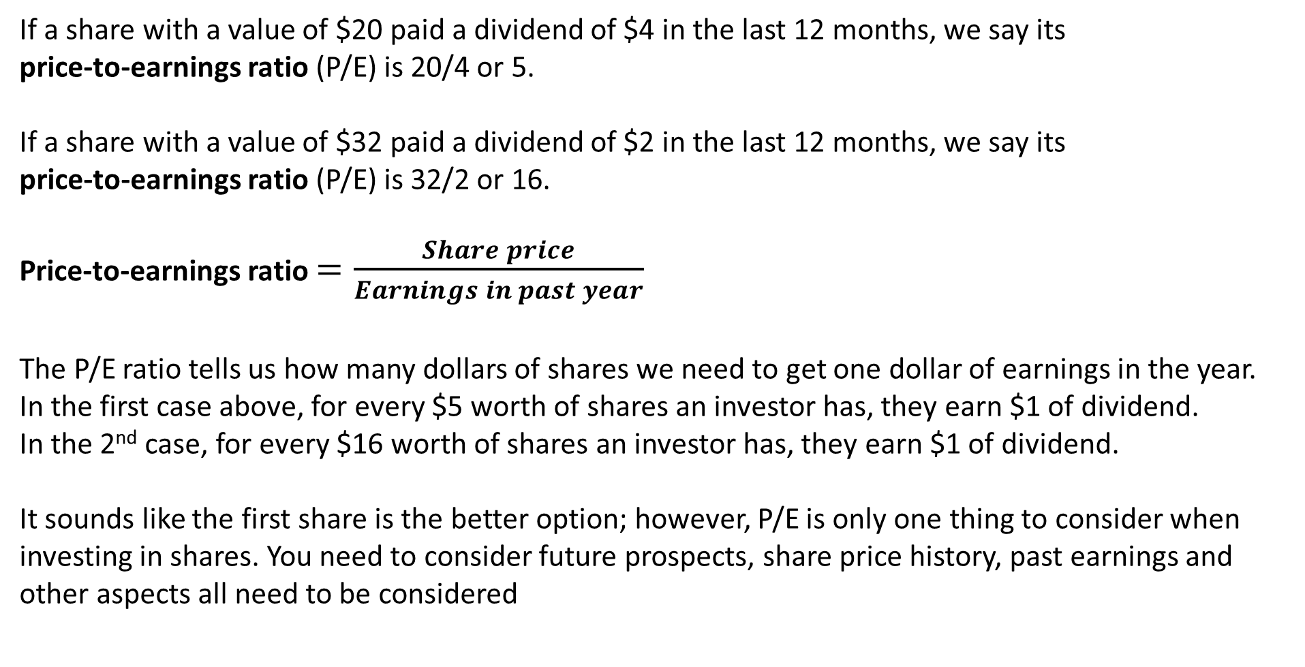
Y11 Apps Chapter 5 Situation 7
If a share with a value of $20 paid a dividend of $4 in the last 12 months, we say its
price-to-earnings ratio (P/E) is 20/4 or 5.
If a share with a value of $32 paid a dividend of $2 in the last 12 months, we say its
price-to-earnings ratio (P/E) is 32/2 or 16.
Price-to-earnings ratio $=\frac{Share price}{Earnings in past year}$
The P/E ratio tells us how many dollars of shares we need to get one dollar of earnings in the year.
In the first case above, for every $5 worth of shares an investor has, they earn $1 of dividend.
In the 2nd case, for every $16 worth of shares an investor has, they earn $1 of dividend.
It sounds like the first share is the better option; however, P/E is only one thing to consider when investing in shares. You need to consider future prospects, share price history, past earnings and other aspects all need to be considered

Slide 24
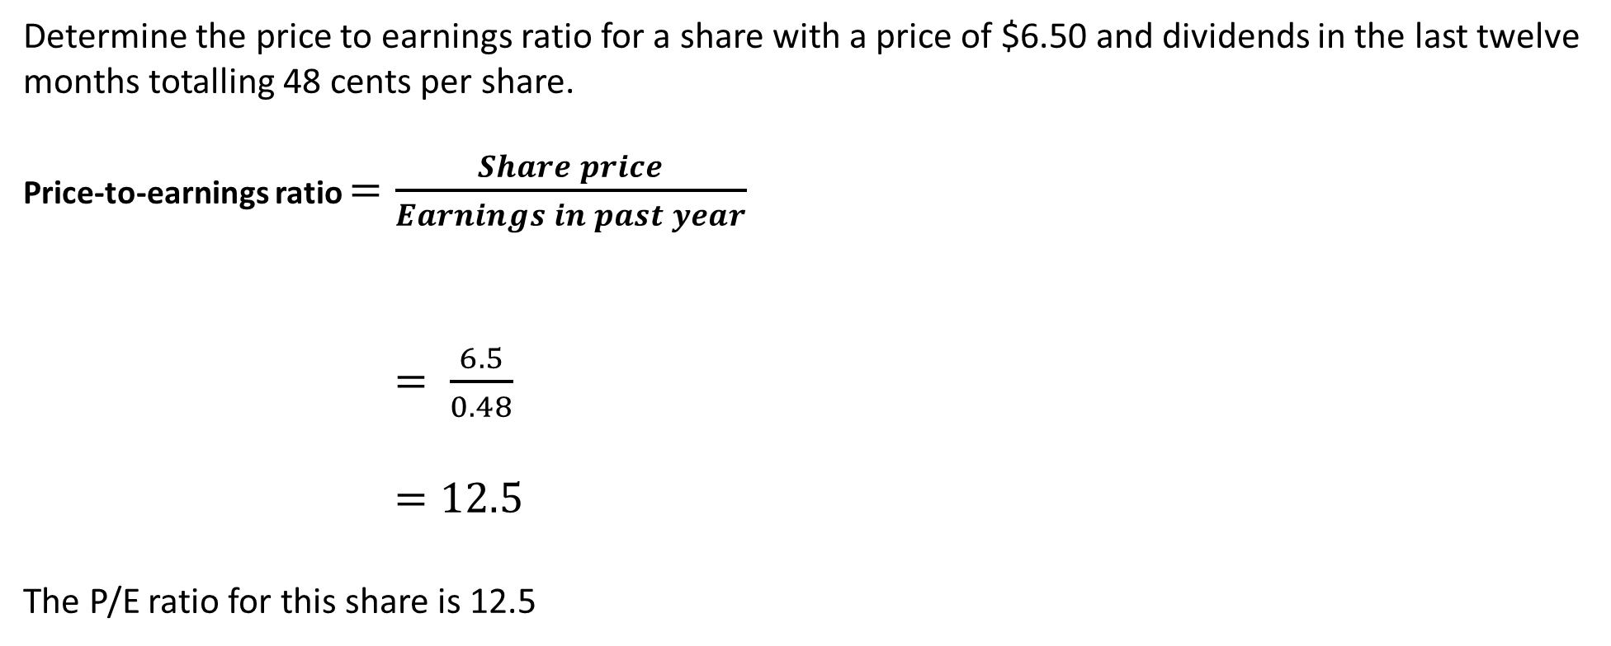
Y11 Apps Chapter 5 Example 3
Now do Exercise 5D
Determine the price to earnings ratio for a share with a price of $6.50 and dividends in the last twelve months totalling 48 cents per share.
Price-to-earnings ratio $=\frac{Share price}{Earnings in past year}$
$= \frac{6.5}{0.48}$
$=12.5$
The P/E ratio for this share is 12.5

